Slide 1

Orcsoft Internal Workshop
Offer Reliable Computing Services On Future Technology

Slide 2
** Before start the section ** First of all, let me introduce my self to you
Name : Parwin Rungpiriyadej { PED }
Work : KTB
Email : parwin@orcsoft.co.th
How about you ?

Slide 3
Day 8 : Web Services

Slide 4
Web Services
Are application components
Are self-contained and self-describing
Communicate using open protocols
Can be discovered using UDDI
Can be used by other applications
HTTP and XML is the basic for Web services

Slide 5
Web Services { Architecture }
Service Registry
Service Provider
Service Requestor
Find
Publish
Bind

Slide 6
Web Services { Components }
XML-RPC
SOAP
UDDI
WSDL

Slide 7
SOAP (Simple Object Access Protocol)
is an application communication protocol
is a format for sending and receiving messages
is platform independent
is based on XML
is a W3C recommendation

Slide 8
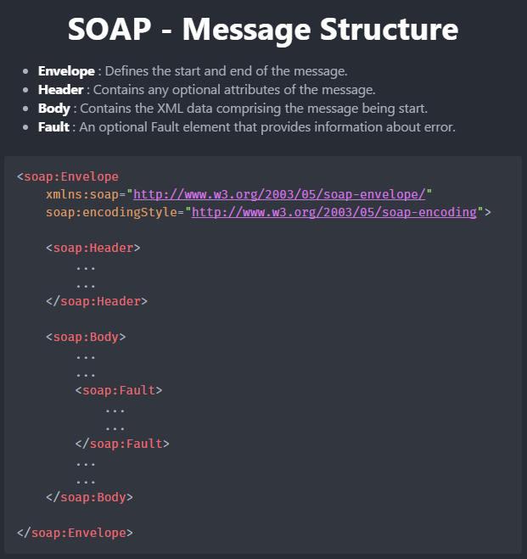
SOAP { Messages }

Slide 9
UDDI { Universal Description, Discovery and Integration }
is an XML-based standard for describing, publishing, and finding web services.
is a specification for a distributed registry of web services
is a platform-independent, open framework
can communicate via SOAP, CORBA, Java RMI Protocol
uses Web Service Definition Language(WSDL) to describe interfaces to web services

Slide 10
WSDL
stands for Web Services Description Language
is used to describe web services
is written in XML
is a W3C recommendation

Slide 11
WSDL { Documents }
Element | Description
<definitions> | Root element of all WSDL documents. Defines the name of web service.
<types> | Defines the data types used by the web service.
<message> | Defines the data elements for each operation.
<portType> | Describes the operations that can be performed and the messages involved.
<binding> | Defines the protocol and data format for each port type.
<port> | Defines an individual endpoint.
<service> | Defines the ports supported by web service.

Slide 12
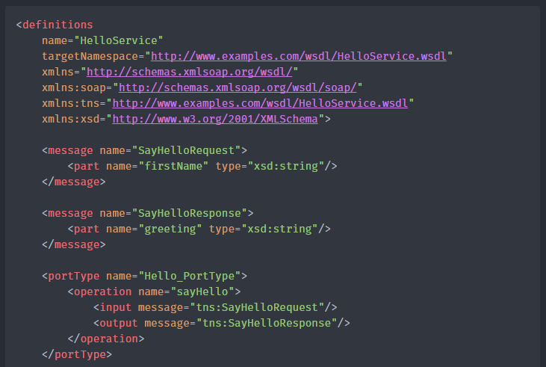

Slide 13
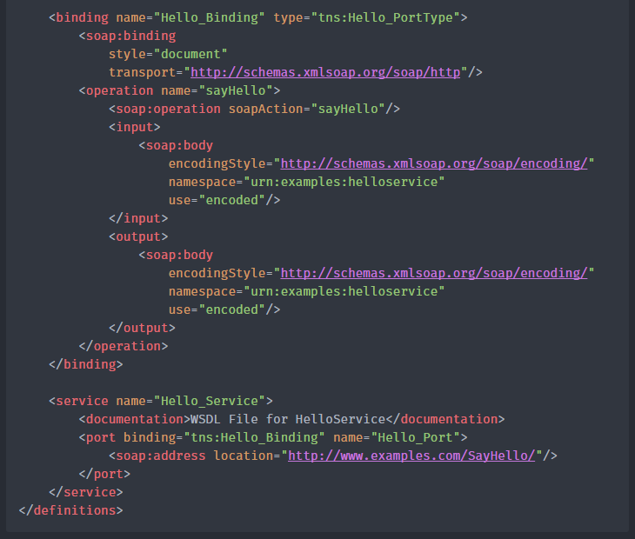

Slide 14
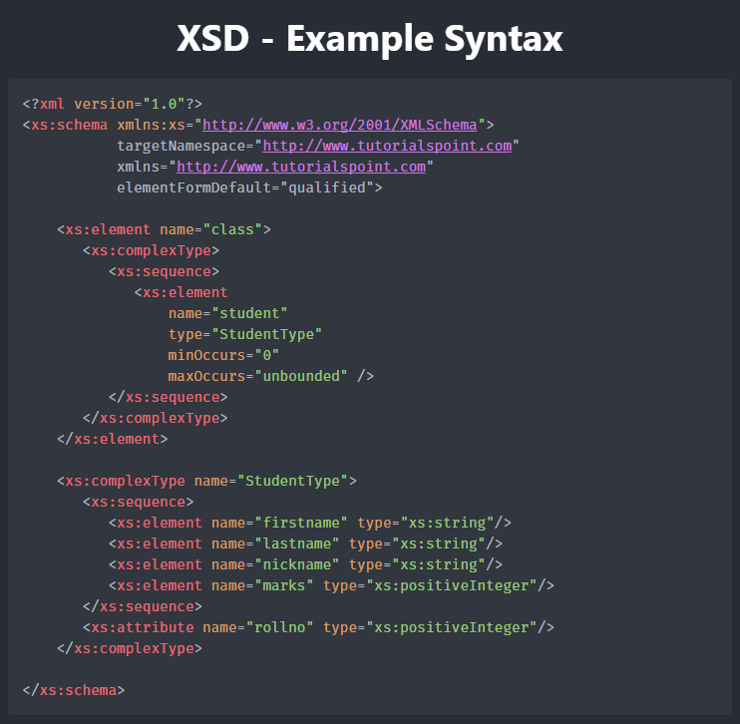

Slide 15
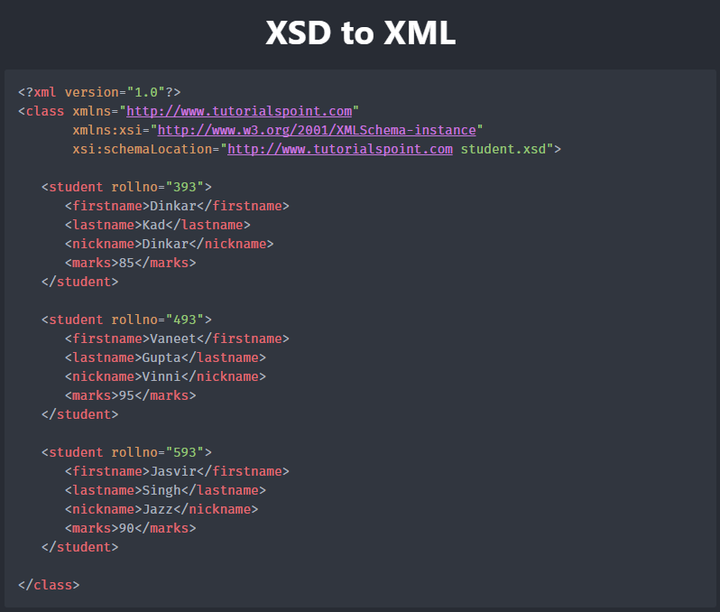

Slide 16
Schema to Java mapping

Slide 17
Java to Schema mapping

Slide 18
Java API for Web Services

Slide 19
JAX-WS Web Services First Application

